Slide 1






ATM SIMULATOR
Kunal
Software Engineer
Yuraza Sohel Kadari
Project Lead
Rishita
Software Testing
Vrushali
Database
Hani
Documentation Head

Slide 2

Agenda
Introduction
Requirements Gathering
Planning
Code Development
User Interface Design
Database Integration
Testing plan
Deployment & Results
Future scope & References
Conclusion

Slide 3
Introduction
Purpose and Scope:
Develop an advanced ATM Simulator mirroring real-world banking interactions.
Project Structure:
Phases: Planning, Design, Development (Java with OOPs concepts), Testing, Presentation.
Ensures a seamless and functional ATM simulation.
Emphasis on Excellence:
Prioritize accuracy, coding standards, and rigorous testing.
Implementing OOPs concepts in Java for efficient code structure.
Team Dynamics:
Effective communication, task distribution, and conflict resolution.
Significance of both task completion and active group participation.
Learning and Reflection:
Reflective stance towards challenges encountered.
Application of newfound knowledge in future projects.

Slide 4

Requirements Gathering ​
Requirements Analysis: Ensuring accurate interpretation and addressing of all specified functionalities.
ATMFunctionalities: Comprehensive understanding of key ATM features. Formulating a clear picture of the desired system behavior and user interactions.
System Design Considerations: Developing a coherent and logical system design. Ensuring seamless transaction flow and user interaction.
Use Case Identification: Identifying and detailing user scenarios comprehensively. Anticipating uncommon and edge case scenarios for robust system design.
Documentation: Producing clear and detailed documentation outlining the design.
Utilizing diagrams where necessary for enhanced clarity.

Slide 5
Planning
Model: Spiral Model
Risk Analysis and Management
Comprehensive identification and analysis of potential risks.
Integration of risk mitigation strategies throughout the project.
Iterative Prototyping
Incremental development with prototyping at each iteration.
Allows for early user feedback and refinement.
Phased Approach
Divides the project into small, manageable phases.
Ensures a systematic and controlled progression.
Flexibility and Adaptability
Emphasis on adapting to changes during each spiral.
Facilitates adjustments based on evolving project requirements.
Continuous Evaluation and Improvement
Regular reviews and evaluations at the end of each spiral.
Incorporation of lessons learned for ongoing enhancements.

Slide 6
Code Development: OOPS Concept
Class Hierarchy(Inheritance):​
ATMGUI class extends JFrame.​
Encapsulation:​
Private instance variables encapsulate internal state.​
Polymorphism:​
Action Performed method demonstrates polymorphism for button clicks.​
Event Handling:​
Action Listeners handle button clicks for login and account creation.​
Random Class:​
Uses Random class to generate a random 6-digit account number.​
Exception Handling:
Basic error handling for negative values in account numbers and PINs.
Dialogs & Date Class:
JOptionPane used for user input and information messages.
Date class used to store the account creation date.
Database Interaction:
Interaction with a database is performed through the ATMdb class using JDBC.
Multithreading:
SwingUtilities.invokeLater ensures GUI operations on the event dispatch thread.
Comments:
Comments are present in the code for improved readability.

Slide 7
User Interface Design
Components:
JFrame with text fields, password fields, buttons, and message dialogs.
Text Fields:
accountNumberField and pinField for user input.
Event Handling:
Implements ActionListener for button clicks.
Buttons:
Buttons for deposit, withdraw, check balance, change PIN, transfer funds, logout, and print statement. Utilizes JOptionPane for user input.
Create Account Dialog:
Takes user input for account name and PIN.
Validates and creates a new account.
Account Creation:
Validates account number and PIN. Checks for existing accounts.
Creates a new account with default values.
Driver Code & Scroll Panes:
Initializes GUI and database in the main method.
Utilizes JScrollPane to handle scrollable text areas.
Swing Components:
Uses Swing components for UI elements.
User Feedback:
Displays messages in JOptionPane dialogs.
Admin Interface:
Additional buttons for accessing all accounts' info and deleting an account.

Slide 8
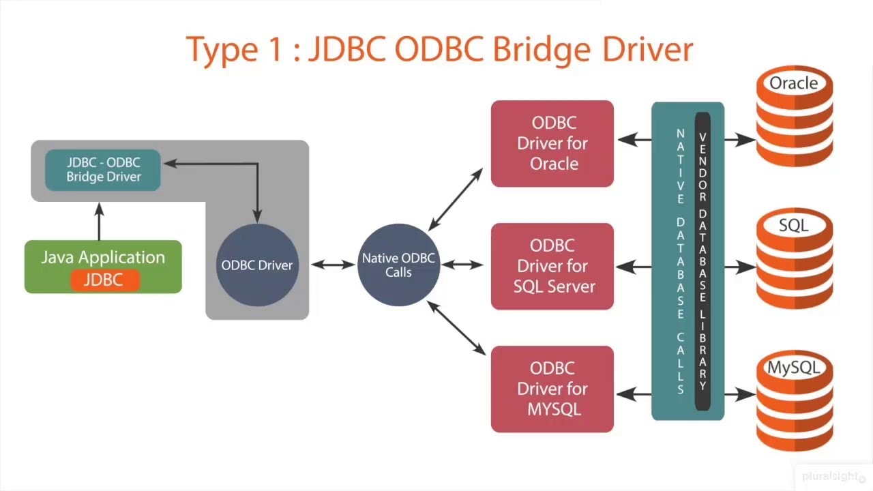
Database Integration
JDBC (Java Database Connectivity):
JDBC facilitates Java applications' interaction with relational databases.
Database Information:
MySQL is used with a specified JDBC URL (JDBC_URL).
Connection Establishment:
DriverManager.getConnection establishes connections to MySQL using provided credentials.
Handling Connection:
The Connection object (connection) manages the database connection.
Executing Queries:
PreparedStatement ensures secure execution of SQL queries. Operations like insert, update, and delete are performed.

Slide 9
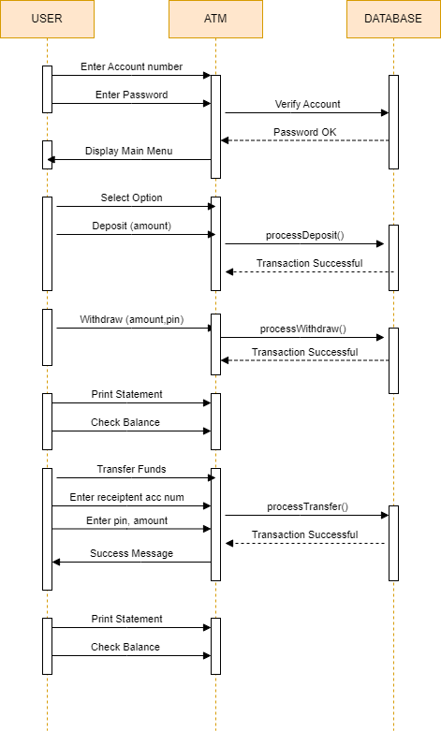
Database Integration ​
​
Transaction Handling:
Transactions (e.g., creating an account) are managed within try-catch blocks.
Retrieving Data:
ResultSet retrieves data for creating relevant objects (e.g., Account).
Exception Handling:
SQLExceptions are caught and handled for robust error management.
Closing Connections:
Connections should be closed, preferably in a finally block.
Prepared Statements for Security:
Utilizing PreparedStatement helps prevent SQL injection attacks by ensuring that input parameters are treated as data, not executable code. This is crucial for enhancing the security of database interactions in the ATM system.

Slide 10
Testing plan
Objective of Testing
Ensure the reliability, functionality, and security of the ATM system.
Verify that the application meets specified requirements.
Testing Levels
Unit Testing:
Verify individual components.
Ensure methods and functions work as expected.
Integration Testing:
Validate interactions between integrated components.
Confirm correct data flow and communication.
System Testing:
Assess the entire system's compliance with requirements.
Evaluate system functionality in various scenarios.

Slide 11
Testing plan ​
Testing Types
Functional Testing: Validate functional requirements. Test features like login, account creation, and transactions.
Security Testing: Ensure sensitive information is protected. Verify resistance to unauthorized access.
Usability Testing: Evaluate the user interface and overall user experience. Confirm user interactions align with expectations.
Test Data:Define the datasets to be used during testing. Include positive and negative scenarios.

Slide 12
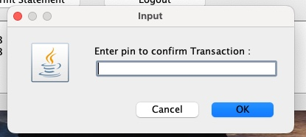
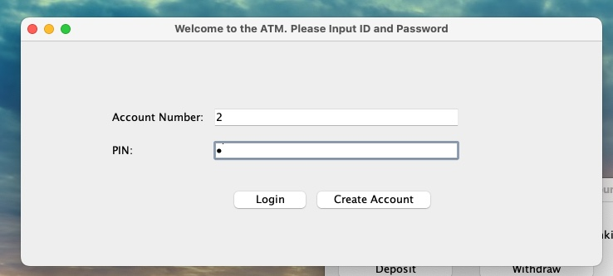
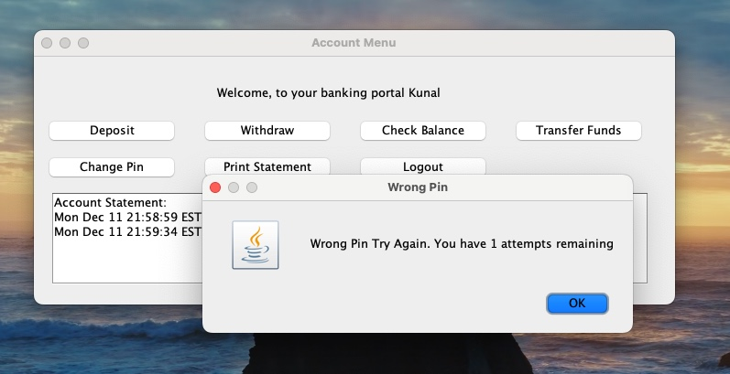
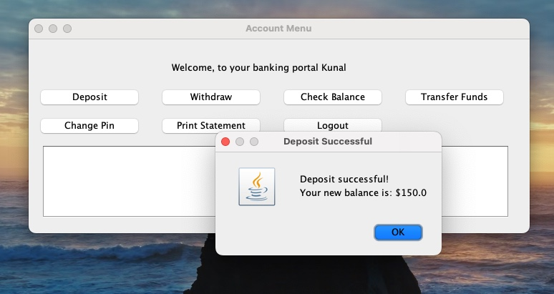
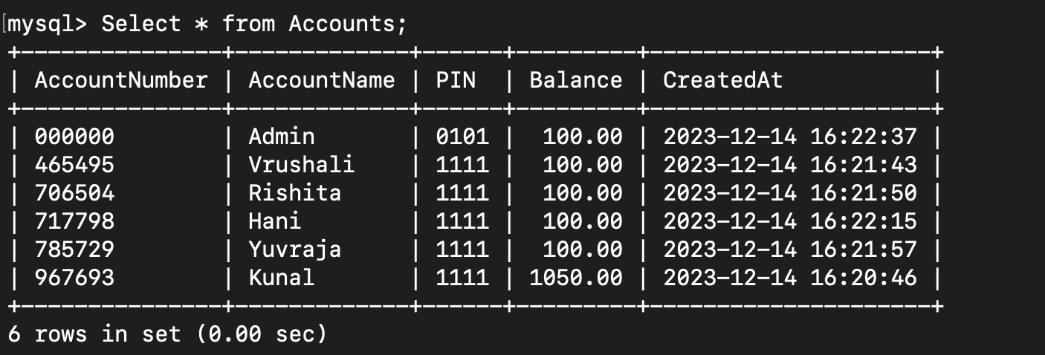
RESULTS

Slide 13
Future scope & References
Enhanced Security Features:
Implement multi-factor authentication for improved security.
Explore biometric authentication methods (fingerprint, facial recognition).
2. Internationalization and Localization:
Allow users to choose their preferred language.
Implement currency conversion for international transactions.
3. Mobile Application Integration:
Develop a mobile application for convenient access.
Ensure compatibility with various mobile platforms (iOS, Android).
4. Contactless Payments:
Integrate contactless payment options (e.g., NFC) for faster transactions.
Stay updated with emerging payment technologies.
5. Customer Support and Notifications:
Implement real-time notifications for transactions and account updates.
Develop an integrated customer support system.
REFERENCES
MySQL Database:
https://www.mysql.com/
https://dev.mysql.com/doc/
MySQL JDBC Driver:
https://dev.mysql.com/downloads/connector/j/
https://dev.mysql.com/doc/connector-j/
Java Database Connectivity (JDBC):
https://docs.oracle.com/javase/tutorial/jdbc/
Jhttps://docs.oracle.com/javase/8/docs/api/java/sql/package-summary.html
Connecting to MySQL with JDBC:
https://www.baeldung.com/java-connect-mysql
Using PreparedStatement in JDBC:
https://docs.oracle.com/javase/8/docs/api/java/sql/PreparedStatement.html
Handling Transactions in JDBC:
https://www.tutorialspoint.com/jdbc/jdbc-transactions.html

Slide 14
Conclusion: Building an Efficient ATM System with Java
OOP Concepts: Inheritance: Modeled relationships between account types. Multithreading: Enabled concurrent user interactions. Error Handling: Ensured robustness with meaningful messages. Polymorphism: Facilitated flexibility through method overriding. Binary Search: Optimized customer account number retrieval.
Database Connectivity (JDBC MySQL):JDBC Integration: Established a seamless MySQL connection.Commented Code: Line-by-line explanations for clarity.
Learning Experience:Hands-On Java Learning: Practical experience in Java development.Application of Concepts: Demonstrated OOP, error handling, and database connectivity.Replication of Genuine ATM System: Immersive learning for real-world application complexities.
Transaction Limits and Applications:Withdrawal/Deposit Limits: Mirrored real-world banking constraints.Realistic Application: Created a system aligned with industry standards.

Slide 15

THANK YOU, ANY QUESTIONS ??​

